Slide 1

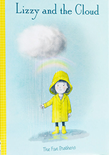



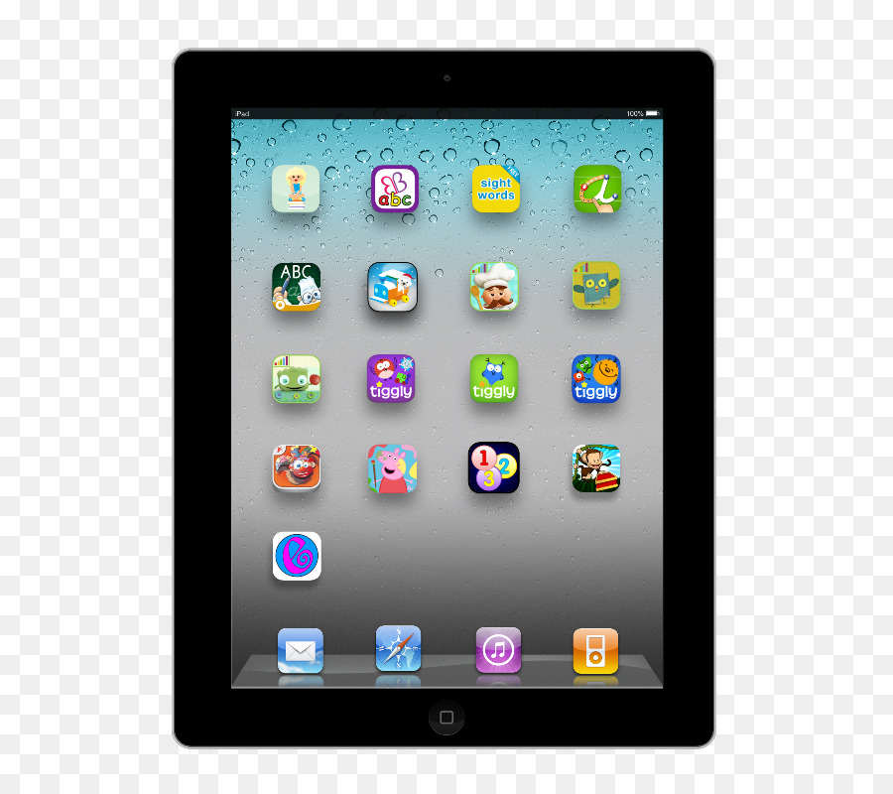


In English we will be continuing our text Astro Girl by Ken Wilson-Max.
The children will be creating posters, guides, letters, short reports and their own narratives.
They will also be writing a fact file all about space.
and we will also be reading Lizzy and the Cloud by The Fan Brothers. We will produce descriptions, adverts / market stall pitches and letters.
Another half term done with lots of new children welcomed into the B by B family. We hope you have had a lovely break! Take a look at what your child will be learning this half term.
Don’t forget parents are welcome on a Friday morning to stay and play until 9am.
Maths: We will be continuing to learn about Multiplication and Division and then move onto learning about Length and Height. We will also investigate charts and graphs and interpret statistics.
Computing - Children will be creating pictures and interpreting and creating spreadsheets using Purple Mash.
R.E We will be learning all about the Easter Story and Jesus’ sacrifice for the world.
P.E will be on a Monday and a Friday taught by Absolute coaches. Please ensure children have the correct PE kit for these days. This half term we will be developing our Skills in tri golf and playing and learning playground games in 20th Century.
In Music we will be:
Combining pulse, rhythm and pitch
We will be investigating
How does music help us to understand our neighbours?
In History we will be learning about the History of Farming in Lancashire
In D.T we will be investigating;
How can I make a figure move? Children will create a moving figure using sliders, levers and linkages.
Science;. We will be learning all about animals including humans. We will looking at the life cycles of insects and animals.
In PSHE we will be learning about keeping healthy by making heallthy choices, keeping myself clean. We will be learning about medicine safety and road safety in order to make a happy, healthy me,

