Slide 1



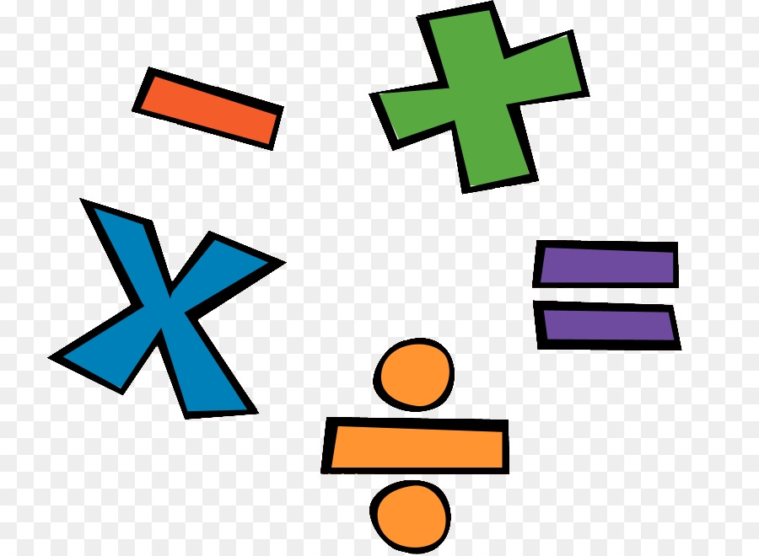
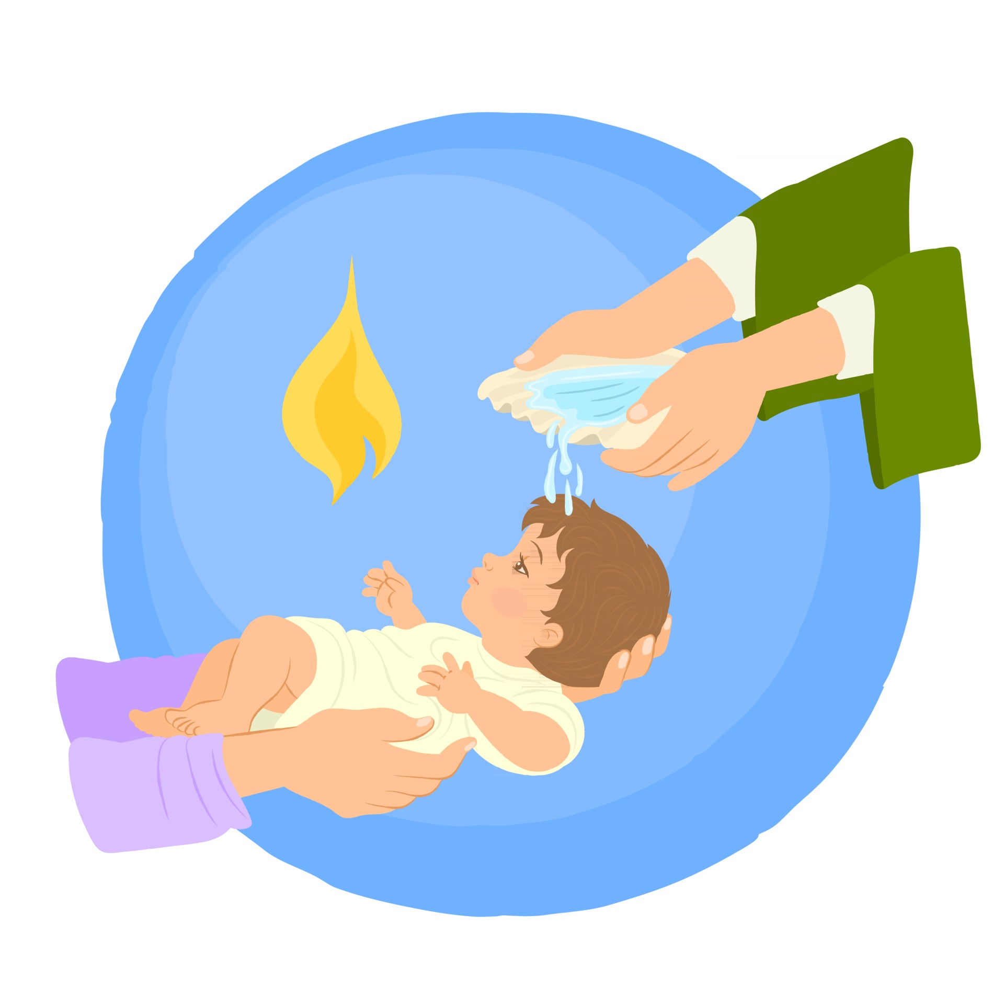
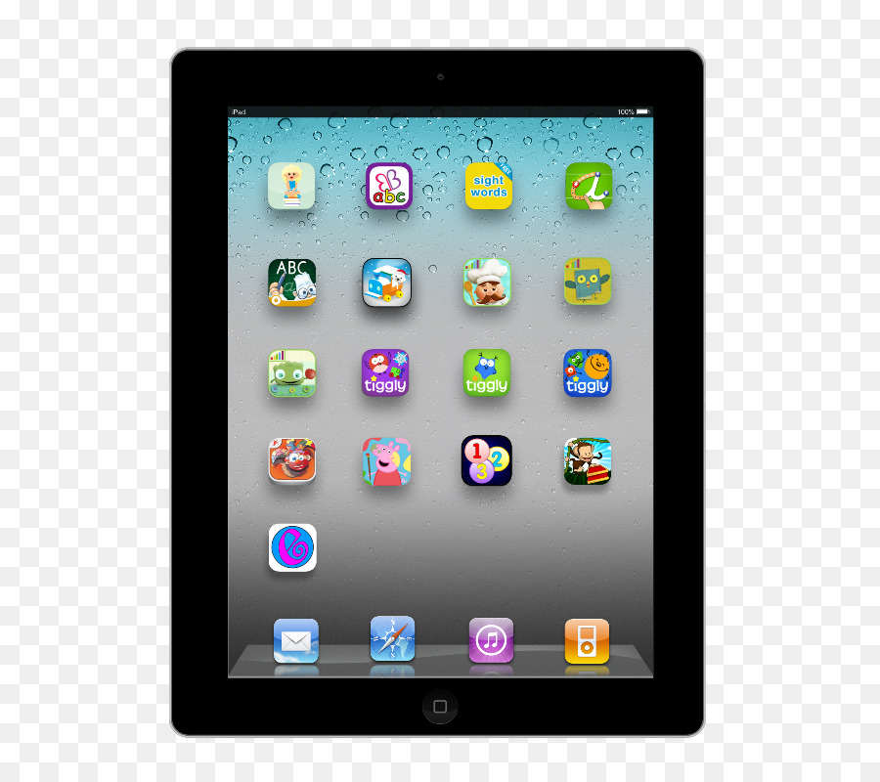

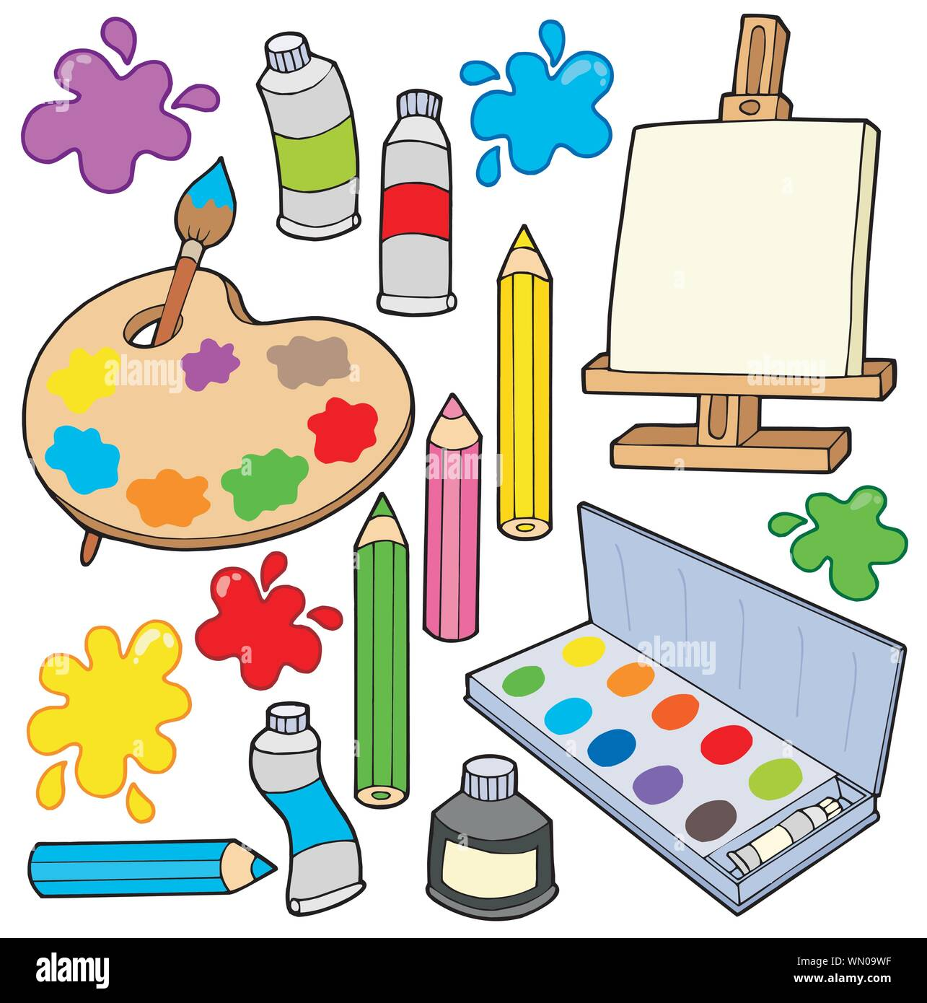
English: We will be continuing our text from last half term Grandpa’s Camper and also reading Beegu by Alexis Deacon and Astro Girl by Ken Wilson-Max.
The children will be creating posters, guides, letters, short reports and their own narratives.
They will also be writing a fact file all about space.
Happy New Year and welcome back from Mrs Francis, Mrs Booth and Mrs Jackson. We hope you have had a lovely Christmas and are ready for the term ahead. We certainly are!! Take a look at what your child will be learning this half term.
Don’t forget parents are welcome on a Friday morning to stay and play until 9am.
Maths: we will be learning to Add and Subtract (within 100) and practise our multiplication and division skills
R.E We will be exploring Jesus and how he was an extra ordinary person who welcomed everyone as a friend and that he had the power to miraculously heal people.
Computing -We will be using Purple Mash to group and sort according to their properties.
In Music children will be introduced to tempo and dynamics. They will be exploring the question: How does music make the world a better place?
P.E will be on a Monday and a Friday taught by Absolute coaches. Please ensure children have the correct PE kit for these days. This half term we will be developing our gymnastic skills and underarm and overarm throws.
In Geography we will be exploring the question: If I were an explorer, where would I go? Children will be able to name and locate the seven continents and five oceans. The children will know the human and physical features of these environments and the names of some countries in each continent.
Art: We will be exploring collage and complete observational drawings of fruit eventually producing a collage similar to the work to an artist- Giuseppe Arcimboldi
Science; We will be exploring materials and their properties.
PSHE: We will be using the website Jigsaw to understand and talk about our dreams and goals, overcoming obstacles and 'celebrating my success’.

