Slide 1


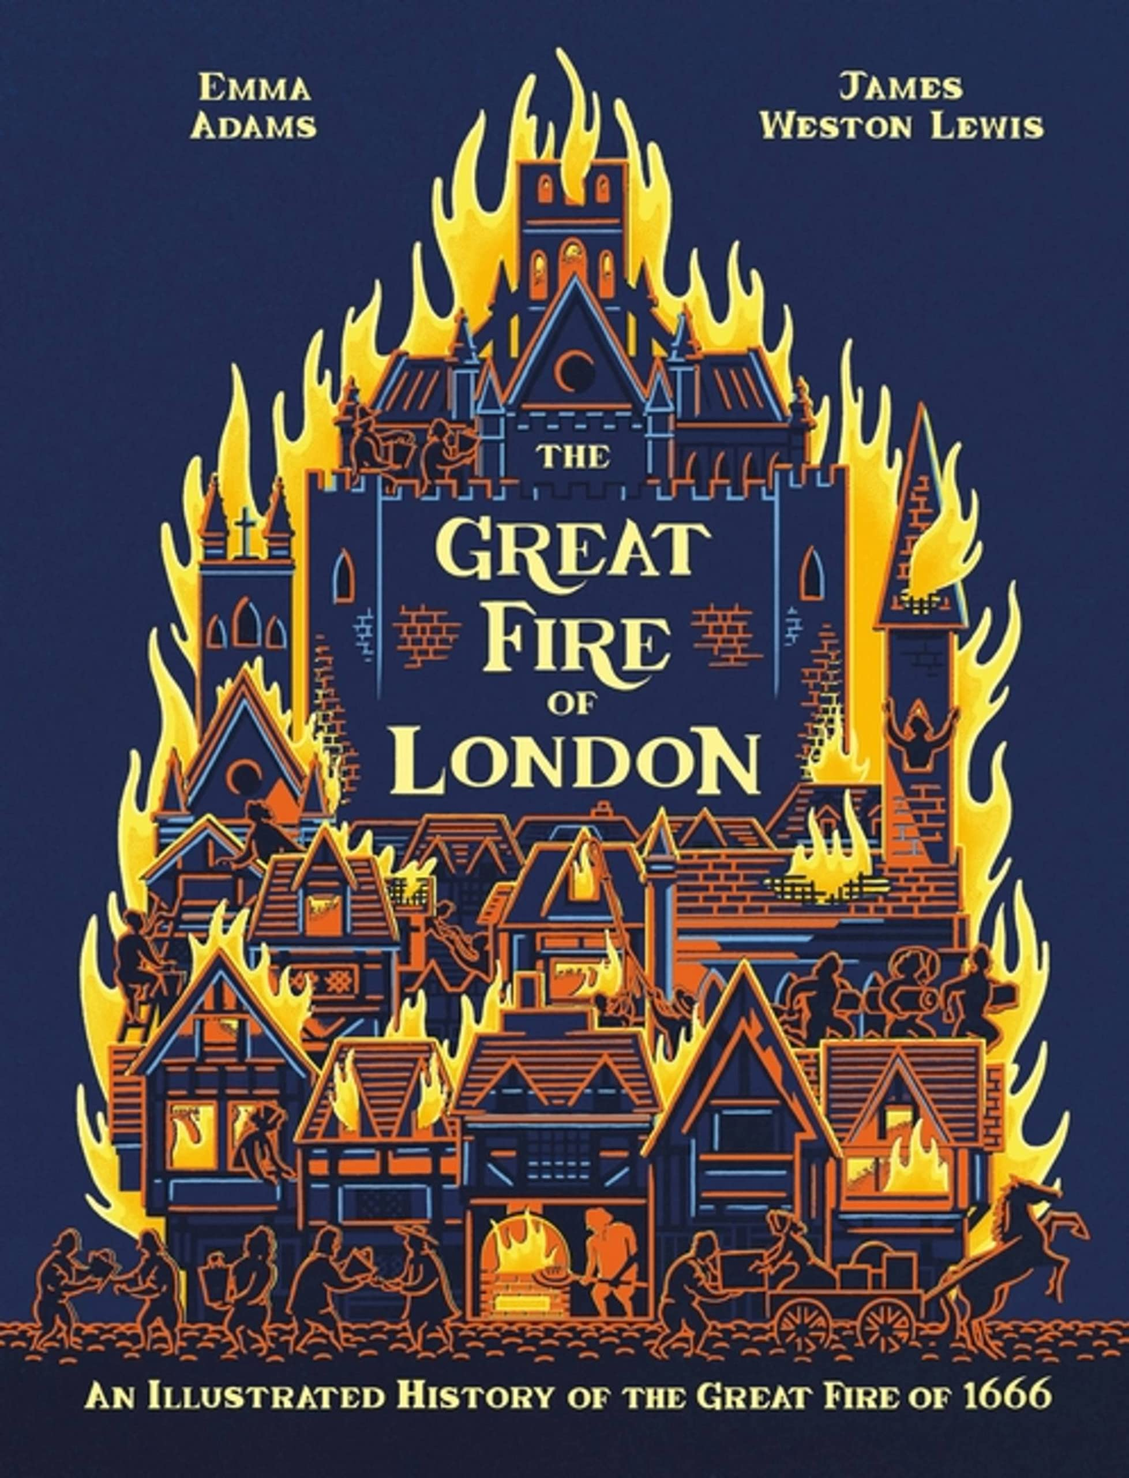

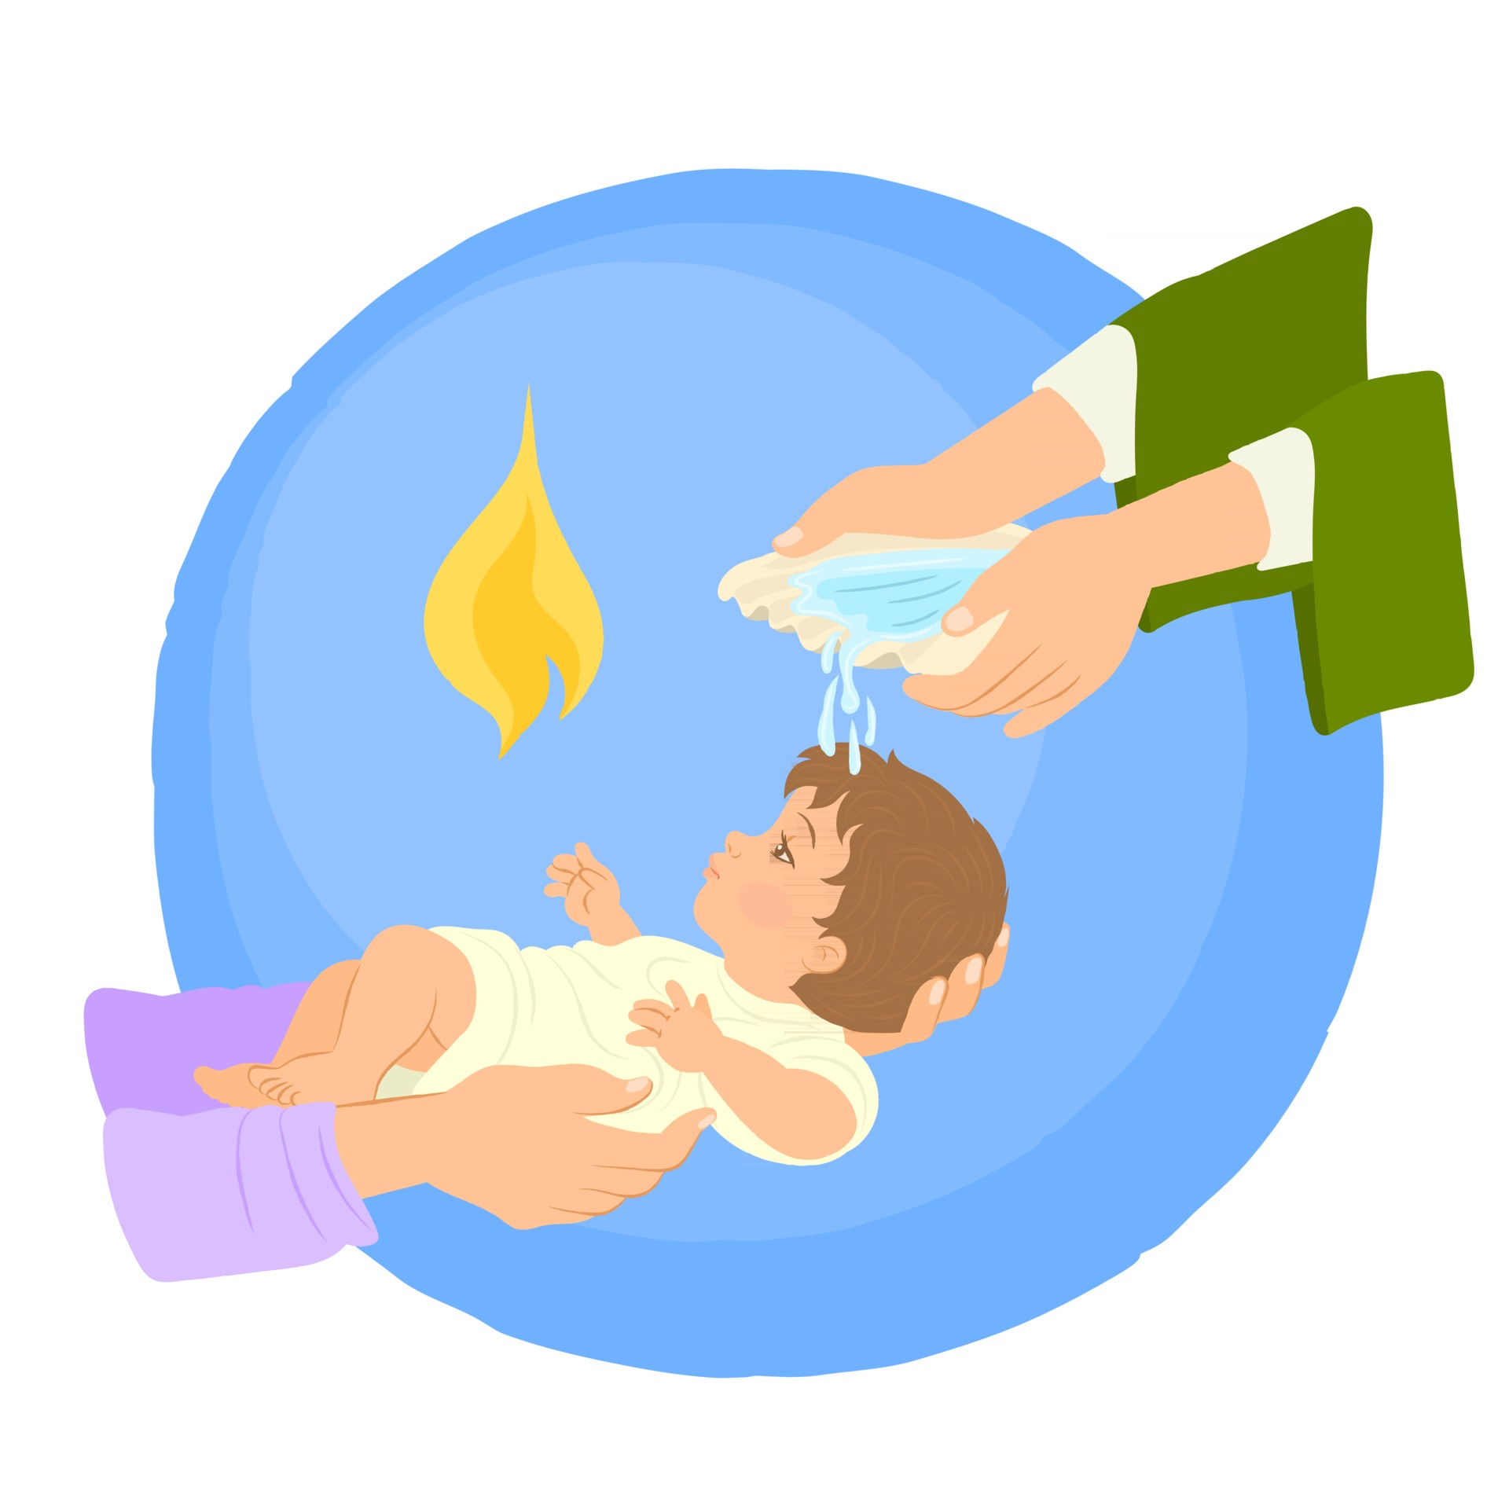

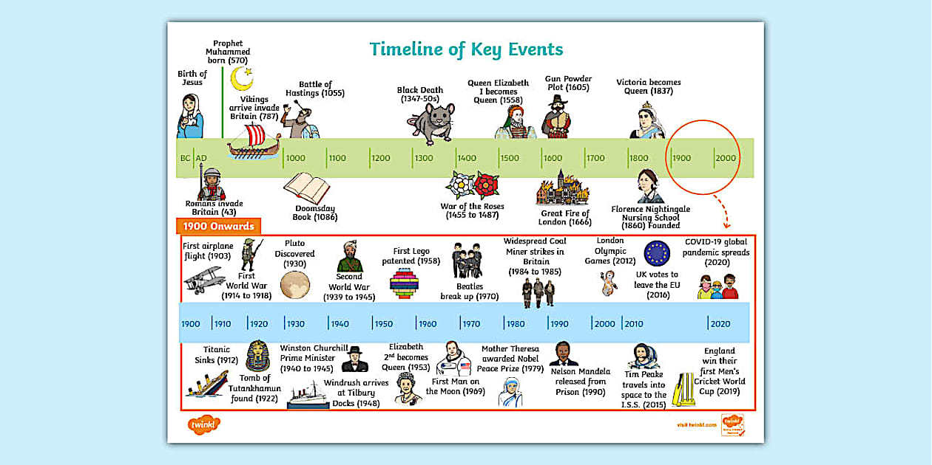

English: We will looking at the texts Grandad’s Camper By Harry Woodgate and The Great Fire of London by Emma Adams. The children will be making persuasive posters and an information booklet a swell as a set of instructions when reading about the Great Fire of London. When studying Grandad's Camper the children will create poetry, interviews and photo album captions before writing their own sequel narrative
Hello and welcome back from Mrs Francis, Mrs Booth and Mrs Jackson. We hope you have had a lovely half term break and are ready for the busy and exciting term ahead with nativities and panto trips etc.
Parents are welcome on Friday mornings from 8.45 -9.00 am to stay and take part in morning activities.
Maths: The children will be looking at the place value of numbers to 100 and learning about 2D shapes.
R.E We will be learning about the birth of Jesus and the importance of the Christmas story to Christians.
Computing - Children will be learning how to search the internet effectively and all about computing instructions (Lego Builders)
PE will be on a Monday and a Friday taught by Absolute coaches. Please ensure children have the correct PE kit for these days. We will be creating a dance to go with The Great Fire of London events and learning to play Bounce Ball.
Music: We will be using Charanga and learning to adding Rhythm and
Pitch How does music
tell stories about the
past?
In History the children will be learning about the Great Fire of London.
Science: In Science children will be learning about the different seasons and how climate changes. Children will also conduct an experiment to measure rainfall.
DT: In DT the children will be investigating the structure of Tudor houses before making their own.
PSHE: We will be Celebrating Difference and thinking about what is bullying?
Making new friends
Celebrating Difference/ Celebrating Me

