Slide 1









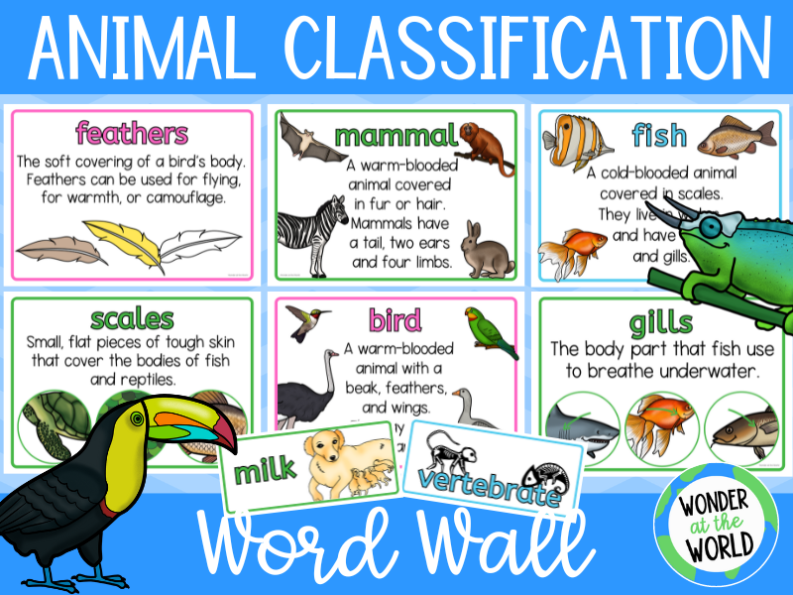
English: This term we will be looking at the texts; Cave Baby, The Odd Egg and Lost and Found. Children will be making guidebooks, writing letters, posters, a set of instructions and a narrative retelling. Children will be heard read 3 times a week in a small reading group and books will be changed once a week (Thursday/ Friday) Children are invited to pick a library book as often as they wish.
Hello and welcome back from Mrs Francis, Mrs Booth and Mrs Jackson. We hope you have had a lovely summer and are ready for the term ahead. We certainly are!! We have been busy giving the classroom a small makeover and can't wait to see all the children's smiling faces. Take a look at what your child will be studying this half term.
Maths: Year 1 and 2 will be learning to identify and count to 20, find one more and one less, use number line sand compare numbers. Children will be adding and subtracting numbers up to 20 including 3 single digits and doubling.
Computing - In Computing children will be learning how to keep safe online.
R.E We will be talking about belonging and baptism.
P.E will be on a Monday and a Friday taught by Absolute coaches. Please ensure children have the correct PE kit for these days
Music: We will be learning to find the beat and answering the question How can we make friends when we sing?
In Geography we are using maps/ globes to identify cold places around the world and habitats. We will also learn about the explorer Shakleton.
Science: In Science we will be investigating different types of animals and which group they belong to.
Art: In Art we will be investigating animal patterns and creating our own prints experimenting with media.
PSHE: We will be exploring who I am in this world and why I am special?
How to keep safe
Our rights and responsibilities.

