Slide 1
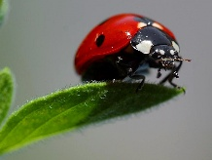



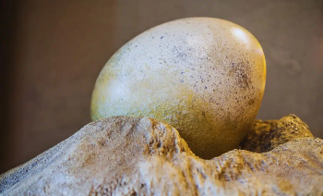

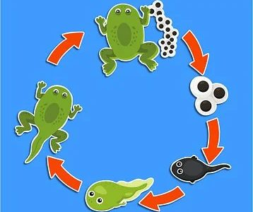
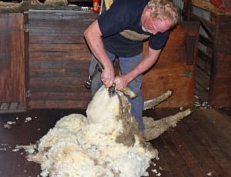
Books we will be reading this half term:
Busy spider
Oi Frog
The Odd Egg
What the Ladybird Heard
Ugly Duckling
Easter story
Cinderella
Another half term done with lots of new children welcomed into the B by B family. We hope you have had a lovely break! Take a look at what your child will be learning this half term.
Don’t forget parents are welcome on a Friday morning to stay and play until 9am.
.
Maths: In Maths the children will be learning about:
Building 9&10,
Make pairs of numbers ·
2d & 3d shapes ·
Matching numerals to quantity 0-10
Computing - In computing the children will be learning to take digital photos using the I-pad.
P.E will be on a Monday and a Friday taught by Absolute coaches. Please ensure children have the correct PE kit for these days
Phonics GPC focus
Review & reconsolidate all sounds & tricky words · Using -s or -es at the end of words
Science: In Science we will be investigating the life cycle of living things and their habitats.
Investigation: On the Farm
I wonder what is inside the egg?
R.E In R.E children will be introduced to stories Jesus will have told and also they will learn about why we celebrate Easter.
PSHE- The children will be learning how to keep healthy through diet, exercise,
and health and hygiene.
Learning themes: Life cycles, different types of animals & habitats, vehicles
Music- The children will be:
Listening to beat & rhythm (radio/cd)
History (UTW) :My past (History of farming)
To listen to and ask questions about the past ·
To compare everyday items from the past and present day – toys, teddies, technology
In DT the children will be designing and making their own vehicles out of construction kits.

