Slide 1

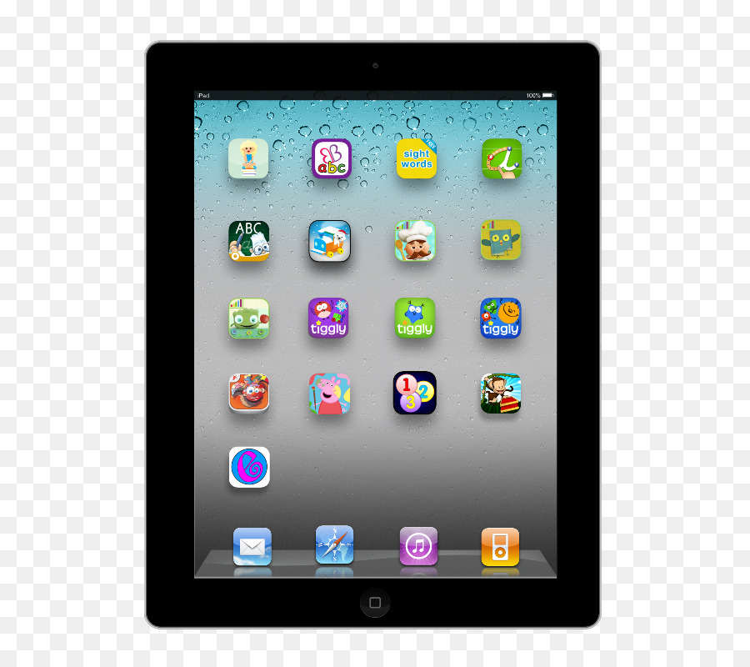

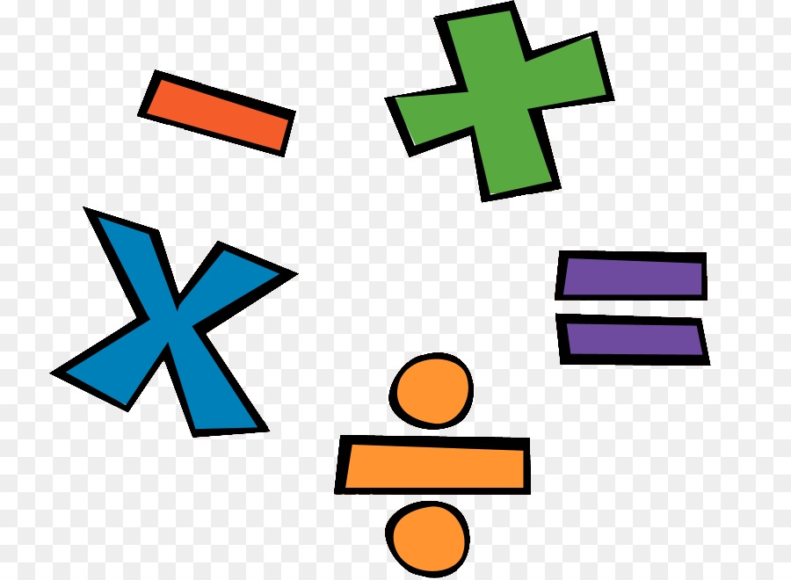
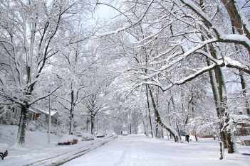
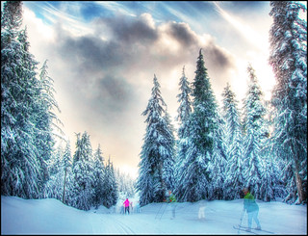

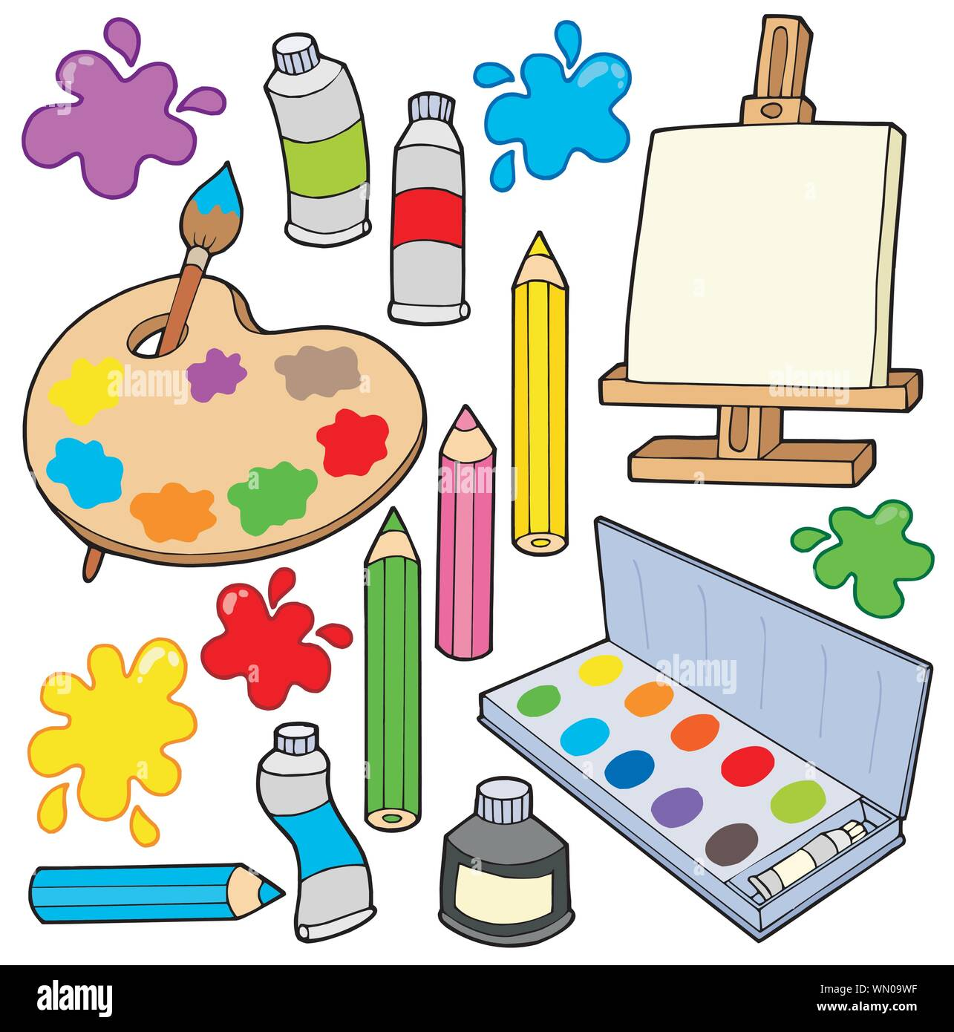
Books we will be reading this half term:
One Snowy Night
Penguin Small
There’s a Bear in my Chair
Mama Panya’s Pancakes
Gruffalo’s Child
Cleversticks
Chicken Licken
The Good Samaritan
Bog Baby
Where’s my Teddy?
Gruffalo
Happy New Year and welcome back from Mrs Francis, Mrs Booth and Mrs Jackson. We hope you have had a lovely Christmas and are ready for the term ahead. We certainly are!! Take a look at what your child will be learning this half term.
Do not forget parents are welcome on a Friday morning to stay and play until 9am.
Maths: In Maths the children will be learning to
Order 0-10
Rote count to 10 and back
Compare mass, length and capacity
To count to 15.
Begin to understand the difference
between odd and even numbers.
P.E will be on a Monday and a Friday taught by Absolute coaches. Please ensure children have the correct PE kit for these days
Computing - In computing the children will be learning to take digital photos using the I-pad.
Phonics GPC focus
ai ee igh oa oo
ar or ur ow oi
ear air er
Tricky words: was,
you, they, my, all, are
Learning themes:
Winter weather
Habitats
Celebrations -
Valentines day and Chinese New Year
Exploration
Collage
Investigation: Ice & Snow
I wonder how it changes?
Around the World
I wonder where they are?
PSHE- In PSHE the children will be
learning about being
proud, showing care &
concern, rules & routines.
Science: In Science we will be investigating growth, diet and health.
R.E In R.E children will be introduced to stories Jesus will have heard from the Old Testament. We will look at the differences between Jesus' world and our world.
We will take part in role play and food tasting. We will hear stories such as Noah's Ark, Joseph and his technicoloured coat, Daniel in the Lion's Den.
Geography (UTW) : We will be exploring the world. Children will learn about explorers in the past and their discoveries. They will learn there are many countries around the world and that people in other countries may speak different languages. Children will continue observing the weather of winter and compare to Autumn.
Music- The children will be:
Exploring loud/quiet, fast/slow sounds using instruments.

