Slide 1

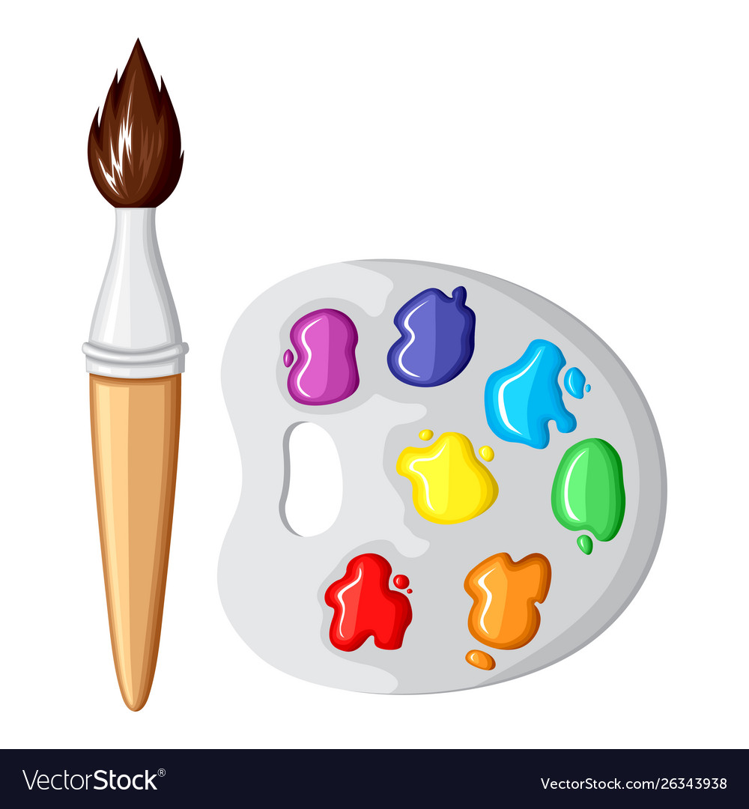


Homework ideas
Maths: Year 2 access TTRS and have a go on it.
Logins will be sent out.
Use a hundred square. Do you know each number?
Or practise number bonds to 100.
Access the Top Marks website to play more number games.
English: Create a fact file about Space.
Write a retelling of the Easter Story.
History: Ask a farmer about farming in the past and write it down to share in class.
Or bring in an interesting item from the past. This could be a toy, photo or an object.
Art: Create a piece of art showcasing the Easter Story or decorate an Easter Egg.
DT: Design and make an Easter card. Can you make a pop up card?
PSHE: Create a healthy snack. This could be a fruit kebab, smoothie. Write your recipe down. Send a picture to one of your teachers or stick in your homework book. Alternatively, can you design a healthy lunch menu? Write and draw your menu.
Science: Choose an animal and create a life cycle poster.
Go down your local river, stream or pond and see if you can find any frogspawn.
Please read as often as possible and get your adult to write in your reading record.

