Slide 1
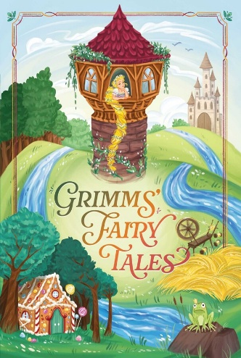



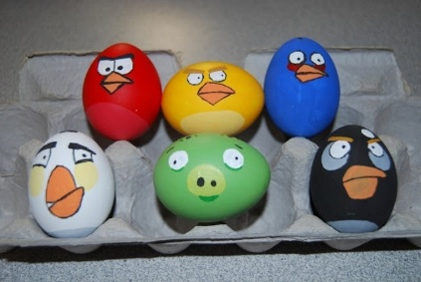
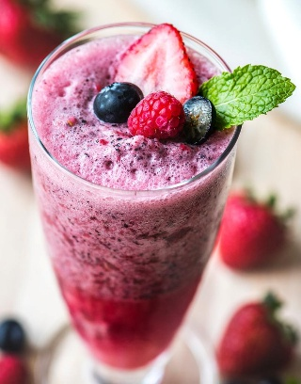
English: Choose a fairy tale and draw a picture.
Can you write a sentence to accompany your drawing?
Homework ideas
Maths: Continue learning to count to 20.
Can the children count backwards?
Learn to double on your fingers.
Look for numbers in the environment. Can you tell an adult what number you see?
Begin to know number bonds to 10.
History: Bring in an interesting item from the past. This could be a toy, photo or an object.
Investigate/ draw and label people who help us in our world.
Art: Create a piece of Art showcasing the Easter Story or decorate an Easter Egg.
Please read as often as possible and get your adult to write in your reading record. Continue learning the GPCs/ Words from the Little Wandle Sheets.
DT/ PSHE: Create a healthy snack. This could be a fruit kebab or a smoothie. Write your recipe down. Send a picture to one of your teachers or stick a photo in your homework book.
Science: Choose an animal and create a life cycle poster.
Go down to your local river, stream or pond and see if you can find any frogspawn.
Geography/ Science: Go on a Spring walk.
What are the signs of Spring? Create a Spring picture. Can you write a sentence?

