Slide 1


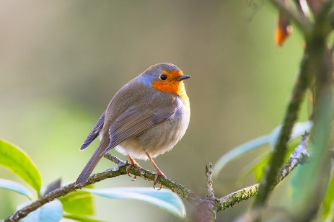
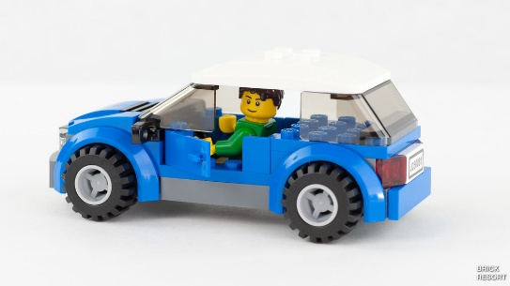
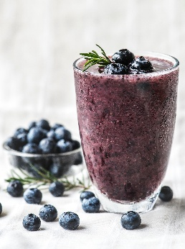

Please read as often as possible and get your adult to write in your reading record.
English: Create a fact file about space and the different planets.
Or
Write about one of your favourite adventures you have been on or would like to go on. What did you do? See? Feel? Hear?
Maths: Practise counting in 2s, 5s and 10s
Have a go at accessing TTRS.
Spring Homework ideas
Maths: Join the Big Bird Count. Sit in your garden for half an hour. Get your binoculars out. Can you create a tally chart for every type of bird you see?
Create a winter acrostic poem.
R.E: Read a Bible story about Jesus. Draw a picture of him helping someone and write a few sentences/ story to accompany your picture.
Geography: Design and make a vehicle to go exploring the world. What materials will you use? Lego, junk modelling? This could be a car, rocket or a boat.
Art: Create your own drawing/ painting/ collage of a fruit or vegetable.
Science: Keep a weather journal for one week. Record the day, temperature and weather.
Science: Go on a materials hunt. Can you find something made of wood, metal, plastic, cotton etc?
DT: Make your own fruit smoothie or fruit kebab. Can you write a recipe?

