Slide 1


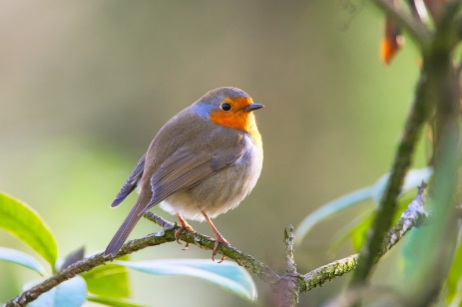
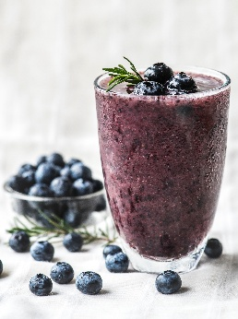
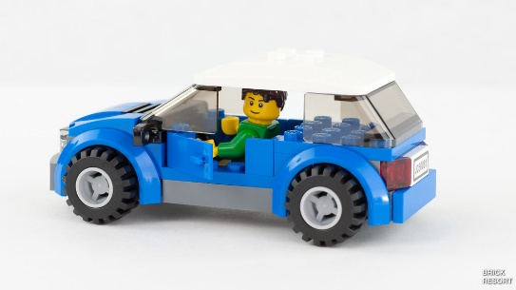

Please read as often as possible and get your adult to write in your reading record. Practise tricky words and GPCs from Autumn 1.
Maths:
Count to 15
Order numbers to 10
Practise counting sets of objects to 10
Count back from 10
Art: Create your own drawing/ painting/ collage of a fruit or vegetable.
Spring Homework ideas
Maths: Join the Big Bird Count. Sit in your garden for half an hour. Get your binoculars out. Learn the names of birds. With a grownup record your findings.
Science: Keep a weather journal for one week. Record the day, temperature and weather.
Geography: Design and make a vehicle to go exploring the world. What materials will you use? Lego, junk modelling? This could be a car, rocket or a boat.
R.E: Read a Bible story about Jesus. Draw a picture of him helping someone and write a few sentences to accompany your picture.
Science: Go on a materials hunt. Can you find something made of wood, metal, plastic, cotton etc?
DT: Make your own fruit smoothie or fruit kebab. Can you write a recipe?

