Slide 1
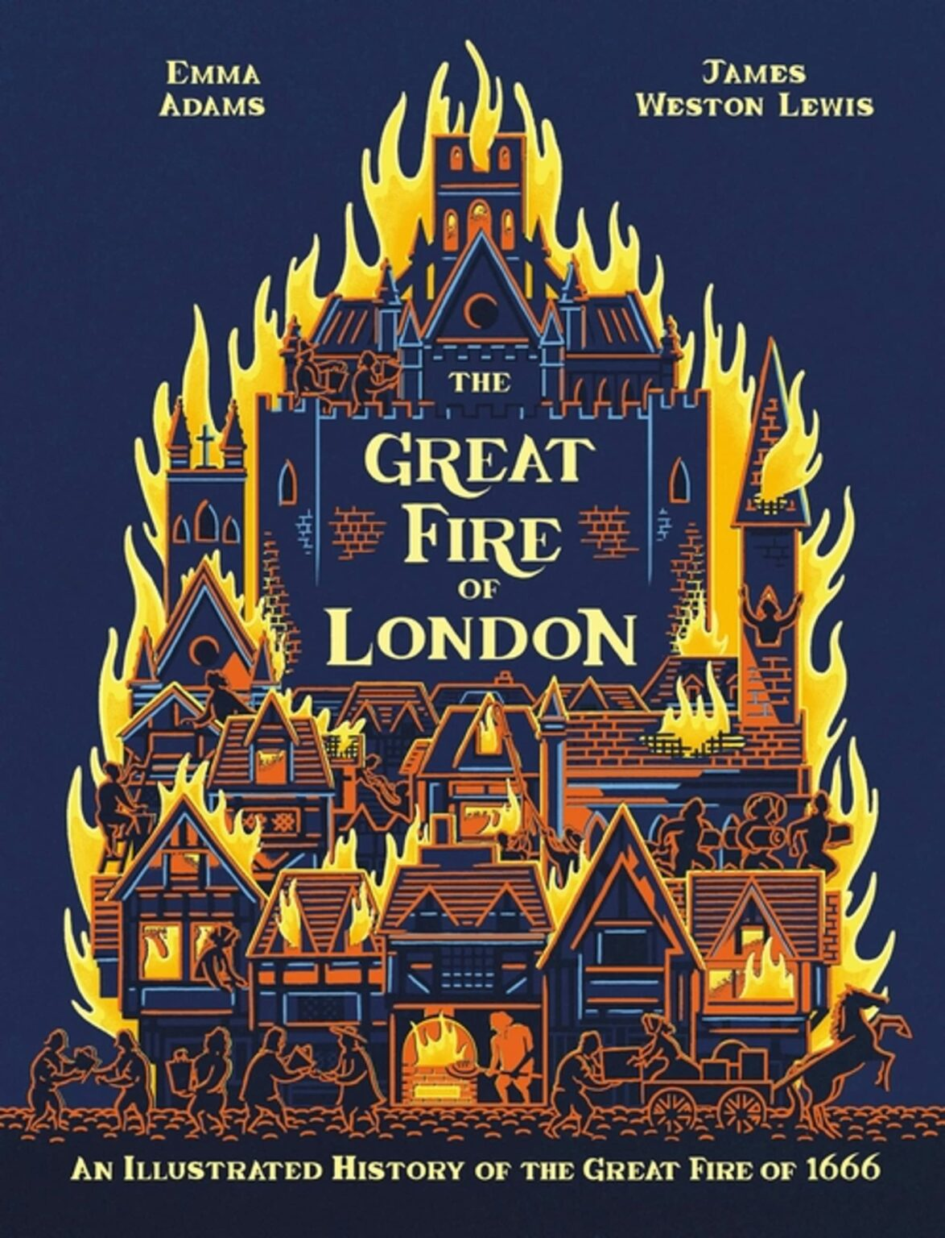


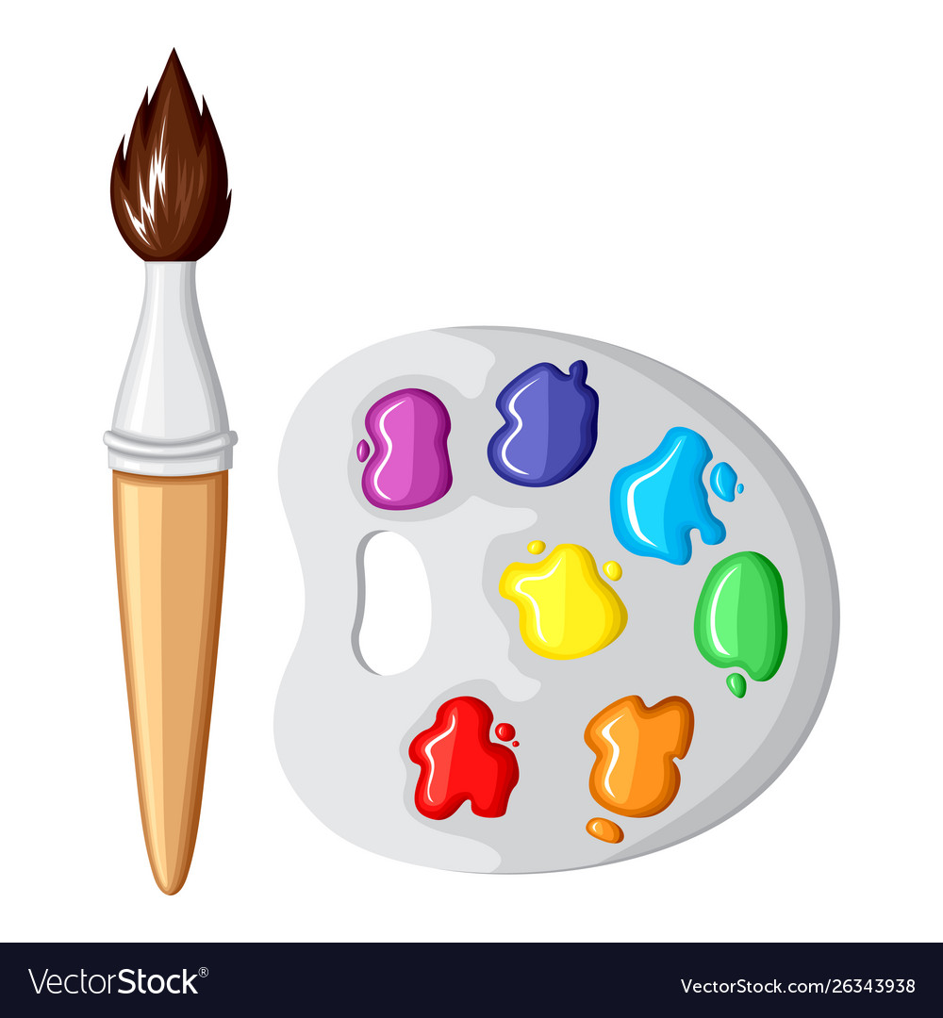

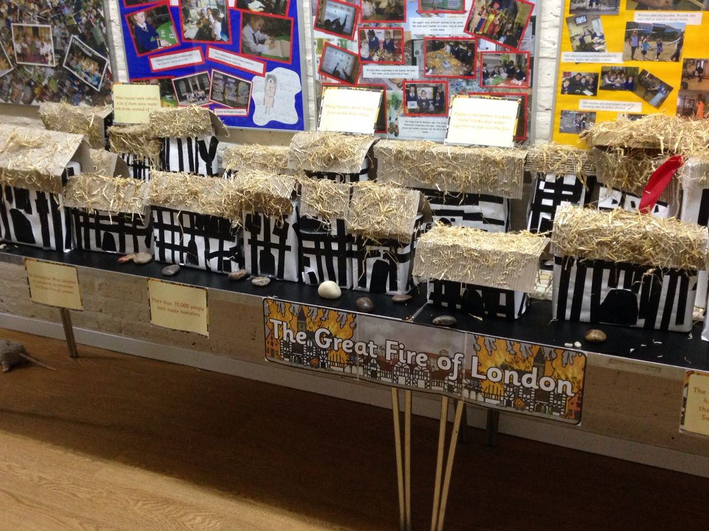
English: How did the people of London try and stop the fire? Write a list of ways.
And/Or
Write a short description of the Great Fire of London.
Homework ideas
Maths: There are 15 fires and 3 firemen. How many fires do they each need to put out?
There are 12 ships and 24 Londoners. How many people will be on each boat?
The fire started on Sunday and finished on Wednesday. How many days did the fire last for?
History: Compare Tudor houses to today's houses. What is the same, what is different?
Art: Paint a scene of the Great Fire of London. What colours are you going to use for the fire and the houses?
R.E: read the Christmas Story- The Birth of Jesus. Create a scene of the Stable and all who attended. You could draw, paint, collage or print pictures from the internet.
DT: Make a model of a building on Pudding Lane. This could be out of junk, lego etc.
Music: Sing nursery rhymes about London and the Great Fire of London. Eg. London’s Burning. London Bridge is Falling Down.
Geography: Draw and label a plan of your own bakery.
Look at the famous landmarks of London today. Can you create a report about one. You could include a picture and some sentences.
Please read as often as possible and get your adult to write in your reading record.

