Slide 1
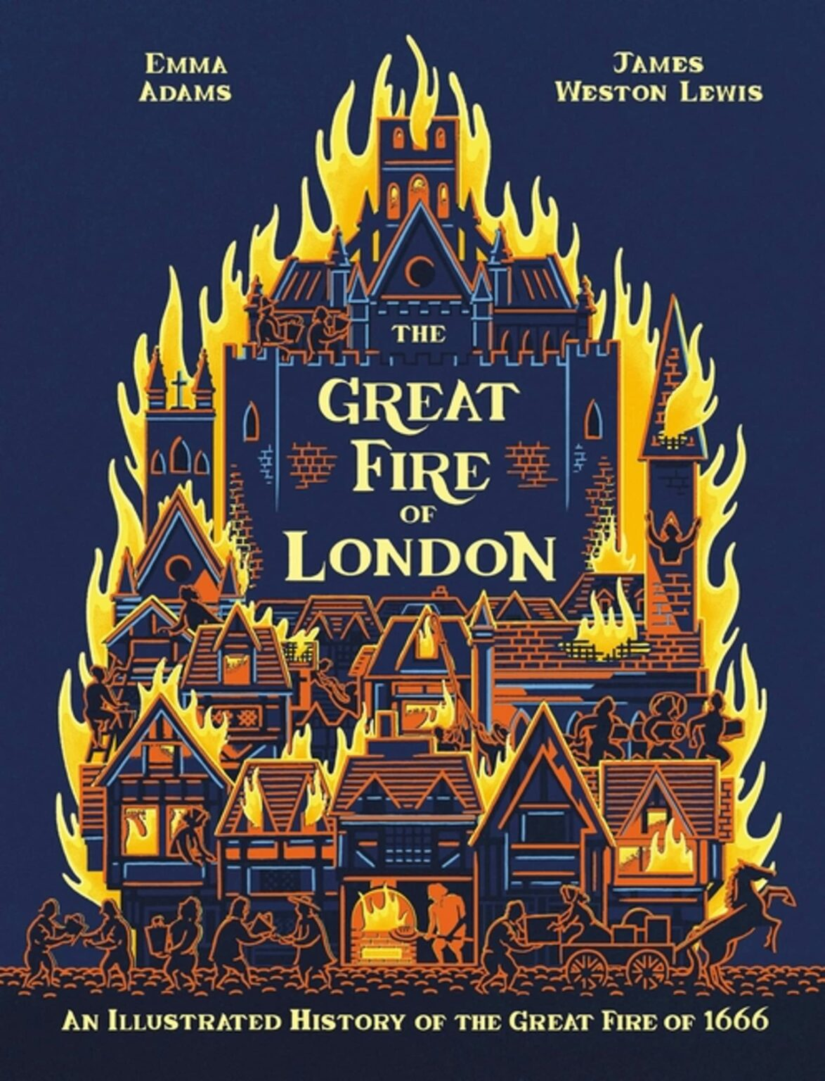

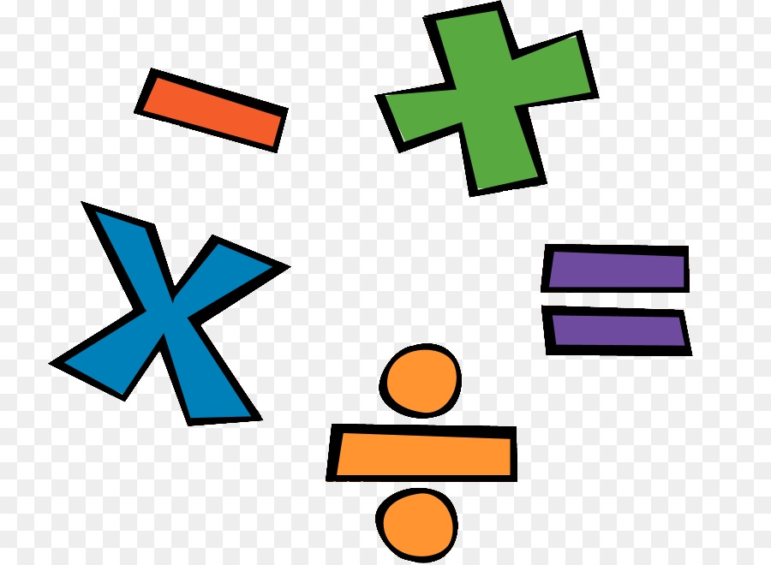
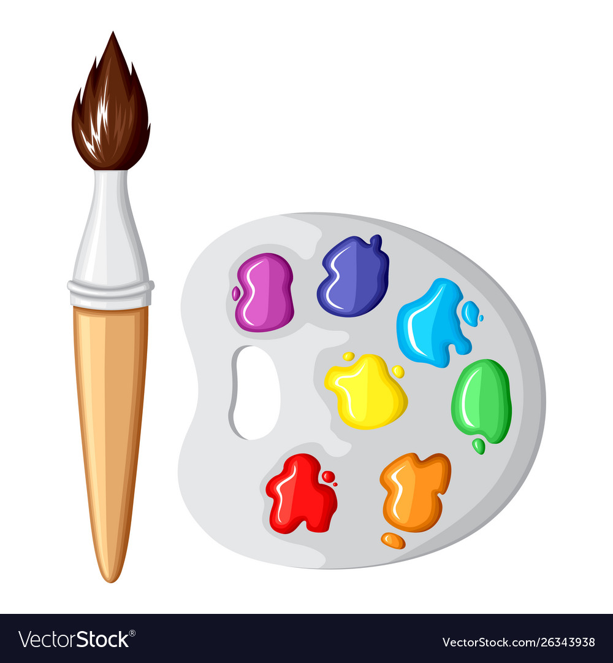

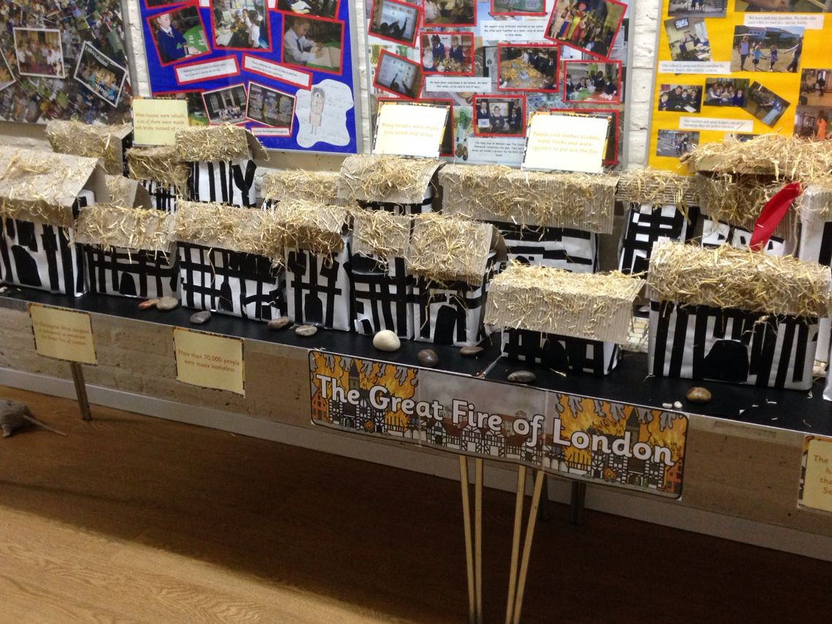
R.E: read the Christmas Story- The Birth of Jesus. Create a scene of the Stable and all who attended. You could draw, paint, collage or print pictures from the internet.
Homework ideas
Maths: Create a shape picture using triangles and circles.
Investigate money. Draw round them and label. Or take rubbings with a wax crayon.
History: Look at houses from the past and compare them to today's houses.
Art: Create firework pictures to show how people celebrate on Bonfire Night, Diwali and New Year's Eve.
DT: Make a model of a house. This could be out of junk, lego etc.
Geography/ Science
Make a list of all things to do with Autumn. Look at the weather, animals that we can see. What do animals do in preparation for Winter? You could make an Autumn wand out of a stick and leaves and acorns.
Investigate what things are made out of? What materials do you know? Can you sort objects?
Music: Sing nursery rhymes about London and the Great Fire of London. Eg. London’s Burning. London Bridge is Falling Down.
Please read as often as possible and get your adult to write in your reading record.

