Slide 1
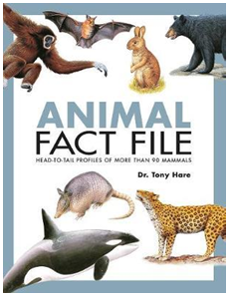


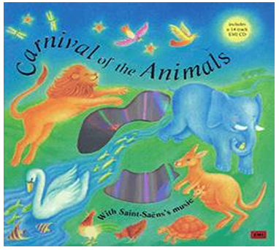
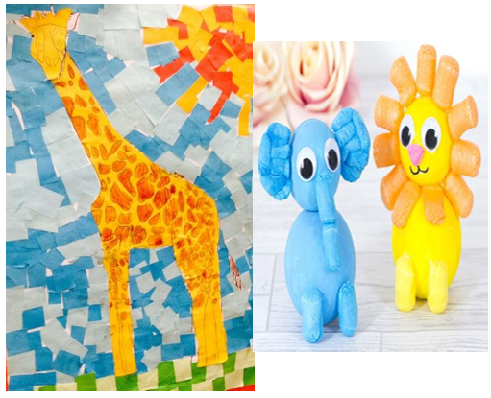

English: Create an animal fact file. Where does it live? What does it eat? What does it look like?
Homework ideas
Maths: Roll a dice 3 times, can you add the numbers together. Write the calculations out in your homework book.
Practise counting in 2s, 5s and 10s.
Computing - Make a poster about how to stay safe online or make an acrostic poem about staying safe whilst using technology.
History: Please bring in some photos from when you were a baby to now so we can order on a timeline.
Art: Find some items at home to print with using paint. Can you make a repeating pattern. Perhaps you could cut up a potato or use natural objects to create a print.
DT: Make a model of an animal using junk, playdough or lego.
Geography: Create your own map of the world and identify the hot and cold countries of the world.
Listen to the music The carnival of the animals. What animals do you imagine? Draw them and write a sentence/ paragraph describing what they are doing.
Please read as often as possible and get your adult to write in your reading record.

