Slide 1
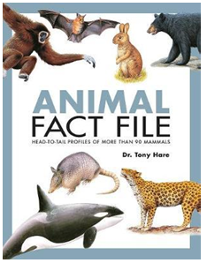

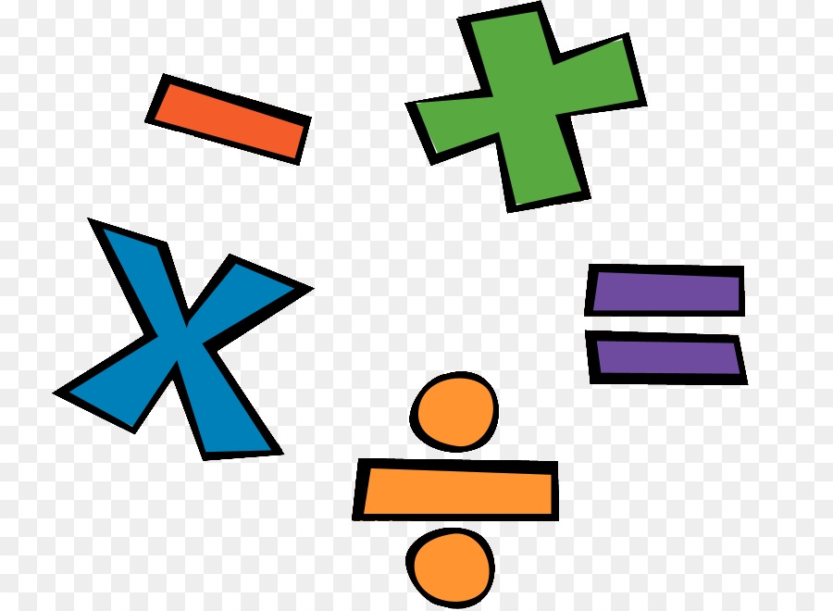
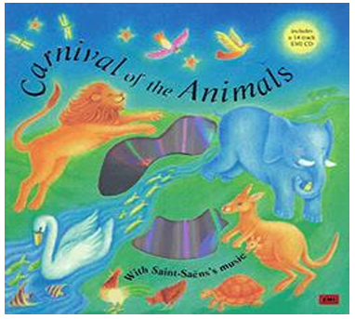
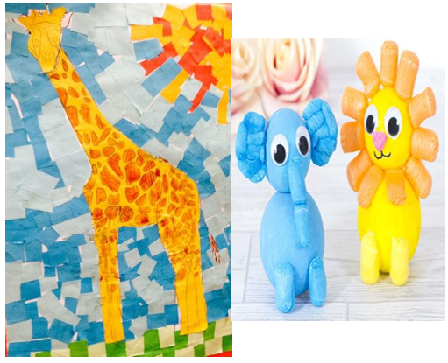

English: Draw a picture of your pet or your favourite animal. With help from an adult can you label it?
Homework ideas
Maths: Practise counting to 10.
Practise counting objects.
For example, how many conkers have you picked today? How many potatoes on your plate? Practise reading numbers to 5. Can you write your numbers to 5?
History: Please bring in some photos from when you were a baby to now so we can order on a timeline.
Art: Find some items at home to print with using paint. Can you make a repeating pattern. Perhaps you could cut up a potato or use natural objects to create a print.
DT: Make a model of an animal using junk, playdough or lego.
Geography: Create your own map of the world and identify the hot and cold countries of the world.
Listen to the music 'The Carnival of the Animals'. What animals do you imagine? Draw them and with an adult write a sentence.
Please read as often as possible and get your adult to write in your reading record.

