Slide 1
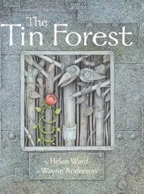
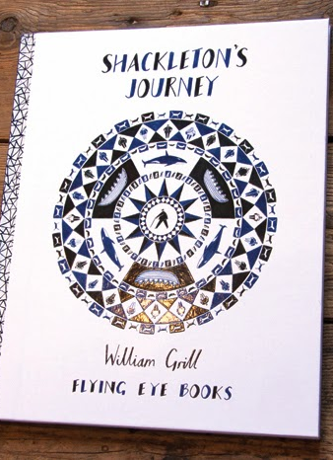

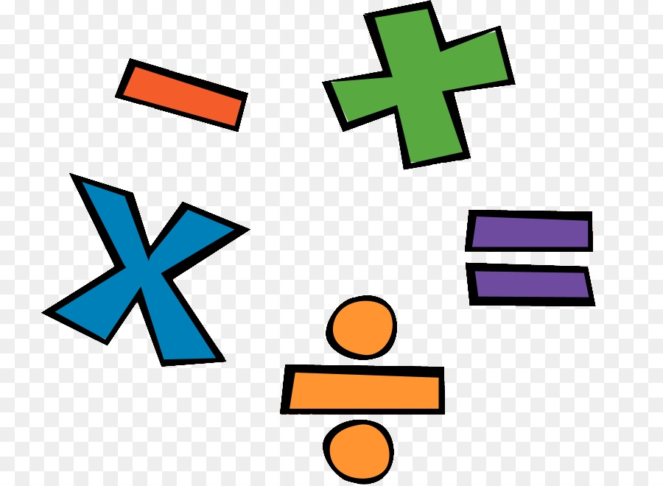
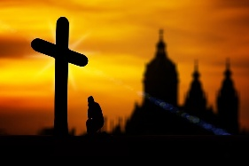

Another half term done with lots of new children welcomed into the B by B family. We hope you have had a lovely break! Take a look at what your child will be learning this half term.
Don’t forget parents are welcome on a Friday morning to stay and learn until 9am.
Maths:
In Maths children will be continuing to explore length and perimeter and Mass and Capacity aswell as Fractions. In year 5 and 6 we will be developing our Multiplication and Division skills. Revisiting fractions, Learning about Decimals ,Area, Perimeter and Volume.
English: We will be reading;
Shackleton’s Journey by William Gril where the children will explore Non-chronological reports, Retellings, character description and write book reviews. They will also read The Tin Forest by Helen Ward and create persuasive posters, information leaflets, postcards and setting descriptions.
P.E will be on a Monday and a Friday taught by Absolute coaches. Please ensure children have the correct PE kit for these days. Girls need to have their hair tied back and earrings taped or out. This term we will be playing rounders and
touch ball.
Computing - We will be Graphing.
Music- We will be exploring the Dragon Song on Charanga.
Geography: We will be looking at how and why good travel, including food and other natural resources.
French: The children will learn vocabulary to describe items of clothing along with the different forms of the indefinite article. Children will learn phrases to describe the weather and vocabulary for compass points.
PSHE- In PSHE, we will be looking at My Friends and Me
Group Dynamics Smoking
Alcohol
Healthy Friendships
Celebrating my Inner strength and Assertiveness
Year 5/6 will be continuing their Dream and Goals topic and then exploring ‘Taking responsibility for my health and wellbeing’ looking at drugs. exploitation , gangs, emotional and mental health managing stress and pressure.
R.E We will be looking at the Easter story in more detail.
Yr3/4 will be investigating whether the cross is a symbol of sadness or joy?
Yr5/6: Will explore who is Jesus and find out what other religions see him as.
D.T: We will be looking at how we can incorporate an electrical circuit into a product when we disgn, make and evaluate a Night Light.
Science: yr 3 and 4 will be learning about sound and year 5 and 6 will be learning about electricity.

