Slide 1




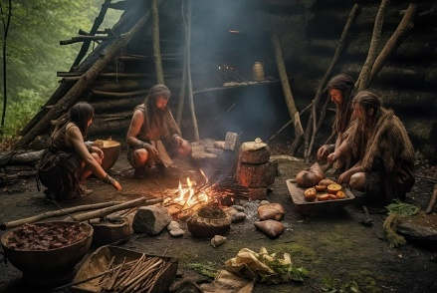

Happy New Year and welcome back from Mrs Pearson, Mrs Booth and Mrs Jackson. We hope you have had a lovely Christmas and are ready for the term ahead. We certainly are!! Take a look at what your child will be learning this half term.
Don’t forget parents are welcome on a Friday morning to stay and learn until 9.00 am.
Maths:
In year 3 and 4 will will be developing our skills I; Multiplication and division and Length and Perimeter.
In year 5 and 6 we will be developing our
Multiplication and Division skills. Learning about Decimals ,Area, Perimeter and Volume.
English: We will be studying the texts;
The First Drawing by Mordicai Gerstein We will produce our own historical narratives, character descriptions, diaries and recounts.
We will also be reading;The Iron Man by Ted Hughes and aim to write letters, diaries, character and setting descriptions and a non-chronological report.
P.E will be on a Monday and a Friday taught by Absolute coaches. Please ensure children have the correct PE kit for these days. Children will be creating an Iron Man dance and also developing their gymnastic skills.
Computing - Coding
Music- The Fresh Prince of Bel-Air
History: We will be looking at agriculture and how it has changed over time particularly in the Stone Age.
French: Children will count in French from one to twelve recognising the written number words. Talk about ages. The children will learn vocabulary to describe items of clothing along with the different forms of the indefinite article.
PSHE- In PSHE, we will be looking at our dreams and goals.
In Year 3 and 4 the children will be discussing; Broken Dreams
Overcoming Disappointment
Creating New Dreams and Achieving Goals
In Year 5 and 6 children will be talking about
Personal Learning Goals
Steps to Success
My Dream for the World
Helping to Make a Difference
R.E We will be talking about;
Year 3 and 4: The ten commandments and rules.
Year 5 and 6: Jesus as a teacher. We will be reading parables.
Art: Children will be looking at camouflage and the artist Colin Jones.
Science: We will be learning about Forces and Magnets

