Slide 1


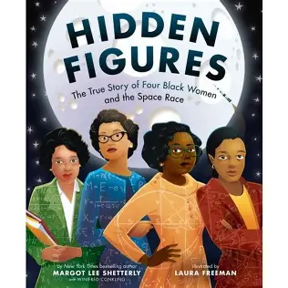
English: We will be reading and studying the text; Hidden Figures by Margot Lee Shetterl. Within this unit we will be writing reports, formal and informal letters, diaries, character descriptions and journalistic writing. We will also be reading The Story of Harvey Milk and the Rainbow Flag by Rob Sanders. The children will produce biographies, thought bubbles, a speech and simple leaflets.
We hope you have had a lovely Easter! Take a look at what your child will be learning this half term. Don’t forget parents are welcome on a Friday morning to stay and learn until 9am.
Maths: In Maths children will be continuing to explore fractions, time and decimals and money. (Year 3 and 4)
Years 5/6 Decimals, percentages and fractions. Ratio Algebra and shape.
P.E will be on a Monday and a Friday taught by Absolute coaches. Please ensure children have the correct PE kit for these days. Girls need to have their hair tied back and earrings taped or out. This term we will be Invasion Games Handball Y3/4 OAA Team Work & Problem Solving 1 Y5/6
Computing -Information technology Unit 5.7 Concept Maps
Music-Charanga unit – Classroom Jazz 1
Geography: We will continue our topic looking at how and why good travel, including food and other natural resources.
PSHE- In PSHE, we will be continuing our topic on; My Friends and Me, Group Dynamics, Smoking, Alcohol, Healthy Friendships We then move onto looking at feelings and relationships of Jealousy Love and Loss Memories Getting On and Falling Out Girlfriends and Boyfriends Celebrating my Relationships with People and Animals
Year 5/6 will be continuing their Dream and Goals topic and then exploring ‘Taking responsibility for my health and wellbeing’ looking at drugs. exploitation , gangs, emotional and mental health managing stress and pressure. What is Mental Health? Staying safe online.
French: Bon Appétit! The children will learn about French food and about different cultural customs. Shopping for French Food. The children will explore different ways to say “the” when talking about shopping.
R.E We will be investigating:
Why Do Christians Believe Jesus Is The Son of God? (yr 3 and 4)
What is the importance of Ascension and Pentecost to Christians?( Year 5 and 6)
History: We will be investigating how the Windrush generation contributed towards British Society?
Science: Year 3 and 4 will be learning about light and shadows. Year 5 and 6 will extend upon this and investigate how lights travels and understand reflections and shadows.
Art: Textiles Linked to Traditional African and Caribbean dress

